Slide 1
Backend Web Development

Slide 2
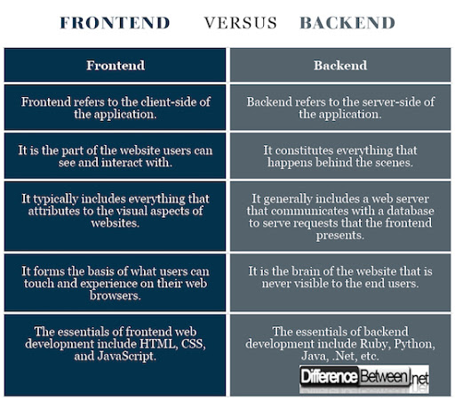

Slide 3
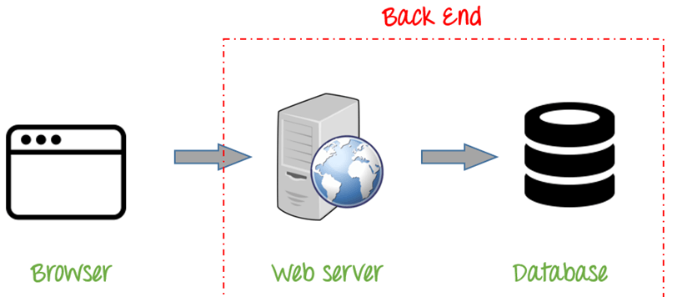
Backend Development Involves

Slide 4
